Slide 1

INTRODUCTION TO GIT
VERSION CONTROL

Slide 2
Learning Outcomes
Understanding Version Control.
Understanding GIT.
Initial GIT setup and configuration.
How GIT can be used.

Slide 3
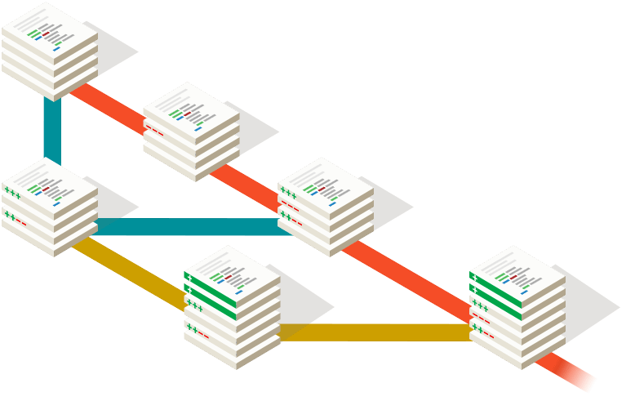
WHAT IS VERSION CONTROL ?
Version control systems are a category of software tools that help a software team manage changes to source code over time.
Version control software keeps track of every modification to the code in a special kind of database.
If a mistake is made, developers can turn back the clock and compare earlier versions of the code to help fix the mistake while minimizing disruption to all team members.

Slide 4
BENEFITS OF VERSION CONTROL
A complete long-term change history of every file.
Branching and merging - keeps multiple streams of work independent from each other while also providing the facility to merge that work back together.
Traceability - It provides the capability of tracing each change made to the software being developed.

Slide 5

WHAT IS GIT ?
By far, the most widely used modern version control system in the world today.
Git is a mature, actively maintained open source project originally developed in 2005 by Linus Torvalds, the famous creator of the Linux operating system kernel.
A staggering number of software projects rely on Git for version control, including commercial projects as well as open source.

Slide 6
WHAT IS GIT ?
GIT has a distributed architecture.
GIT does not have only one single place for the full version history of the software.
Every developer’s working copy of the code is also a repository that can contain the full history of all changes.
This is contrary to the architecture of once-popular version control systems like CVS or Subversion (also known as SVN)

Slide 7
INSTALLING GIT
Go to https://git-scm.com/ to download an appropriate version for your operating system.
For Linux based operating systems you can install via your terminal.
For Ubuntu: sudo apt-get install git
For Mac OS: brew install git

Slide 8
GETTING STARTED
1.Initial GIT setup
2. Initializing Repository.
3. Saving Changes.
4. Sending saved changes to a remote repository.
5. Fetching Changes from remote repository

Slide 9
1. Initial GIT Setup
1. Setup your name:
$ git config --global user.name ”John Doe”
2. Confirm your name is properly setup:
$ git config --global user.name
3. Set your email
$ git config --global user.email “john.doe@mail.com”

Slide 10
2. Initializing GIT Repository
Create a new directory for your new project.
Initialize a new GIT repository using the following command
$ git init
Check for the status of the initialized GIT repository using the following command.
$git status

Slide 11
3. Saving changes
Create a sample file for your project “index.html” using your favorite text editor.
Add the newly created file to your repository ‘s staging area using the following command.
$git add index.html
Commit the changes you made using the following command
$git commit –m “My First Commit”

Slide 12



4. Sending saved changes to a remote repository
We can setup a remote GIT server to receive all the changes we’ve committed so far.
For this training we can use a free cloud service (Github) to act as our remote GIT server.
There are various self hosted services that exist out there e.g. GOGS, GITLAB.

Slide 13
4. Sending saved changes to a remote repository
In order to create, view, and delete connections to other repositories we shall use the git remote command
GIT can use the following protocols for data transfer:
Local Protocol
HTTP Protocol
SSH Protocol

Slide 14
4. Sending saved changes to a remote repository
For this case we shall use SSH because:
SSH is relatively easy to set up
Access over SSH is secure - all data transfer is encrypted and authenticated
SSH is efficient, making the data as compact as possible before transferring it.
Notes:
For more information on the different GIT protocols go to
https://git-scm.com/book/en/v2/Git-on-the-Server-The-Protocols

Slide 15
4. Sending saved changes to a remote repository
In order to use SSH you need to setup your ssh keys which can be achieved by runnning the following command
$ ssh-keygen -t rsa -b 4096 -C “your_email@example.com”
Save the key to the prompted default path.

Slide 16
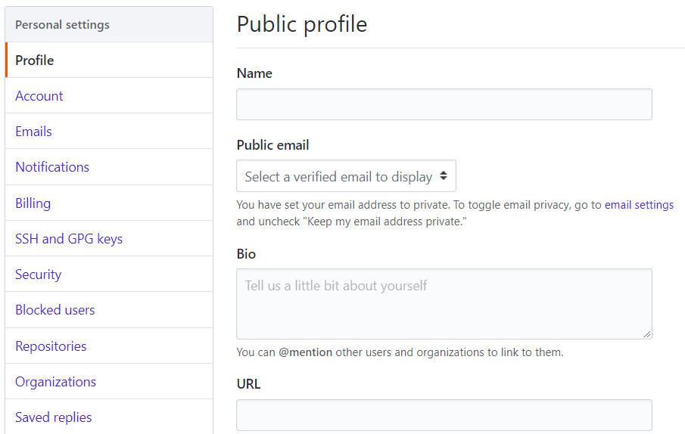
4. Sending saved changes to a remote repository
Open the contents of the id_rsa.pub (Your Public Key) add them to your free Github account.

Slide 17
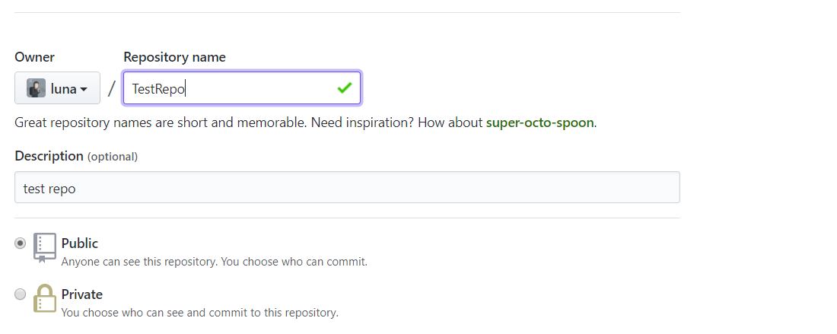
4. Sending saved changes to a remote repository
Create a new repository on your Github account

Slide 18
4. Sending saved changes to a remote repository
On your terminal add the remote server
$ git remote add origin git@github.com:luna/TestRepo.git
Push the changes to the remote server
$ git push -u origin master
Refresh your Github page to verify that the changes have been sent.

Slide 19
5. Fetching changes from remote repository
Changes from the remote branch can be fetched using the following command
$ git fetch origin
To merge the changes you’ve fetched from the remote repository with your local source code you can use
$ git merge origin/master
Alternatively, you can simplify the whole process with one command
$ git pull origin

Slide 20
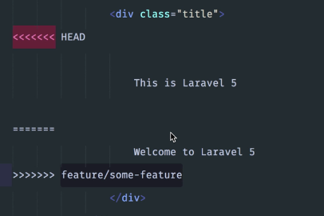
MERGE CONFLICTS
Merge conflicts may occur if competing changes are made to the same line of a file or when a file is deleted that another person is attempting to edit.
To fix merge conflics, open the file that has failed and decide which changes you want to keep.

Slide 21
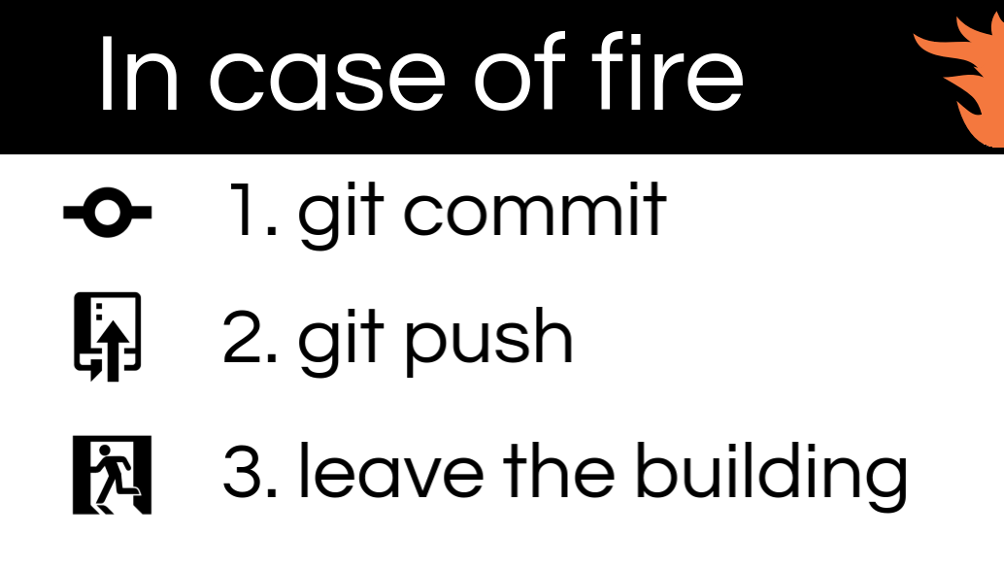

Slide 22
Exercise
Make a proper GIT setup on your computer.
Initialized a new git repository to your newly created JAVA project and make your initial commit “Initialize Project”
Push your commit to your remote Github repository.

